Slide 1
Research and SAA: Research Forum Update
Nance McGovern
Co-chair/Co-founder Research Forum
14th Research Forum – August 5, 2020

Slide 2
Research Forum: Scope and Purpose
Scope - include and balance:
Innovative Practice – with implications/benefits beyond local use
Research – across a broad spectrum to benefit our applied domain
Contributors: researchers and practitioners, educators and students, early-career to long-term, whoever is working in the space …
Purpose: encourage members, archivists, and others to engage a growing range of research and innovative practice focused on enhancing and expanding archival principles, practice, and community

Slide 3
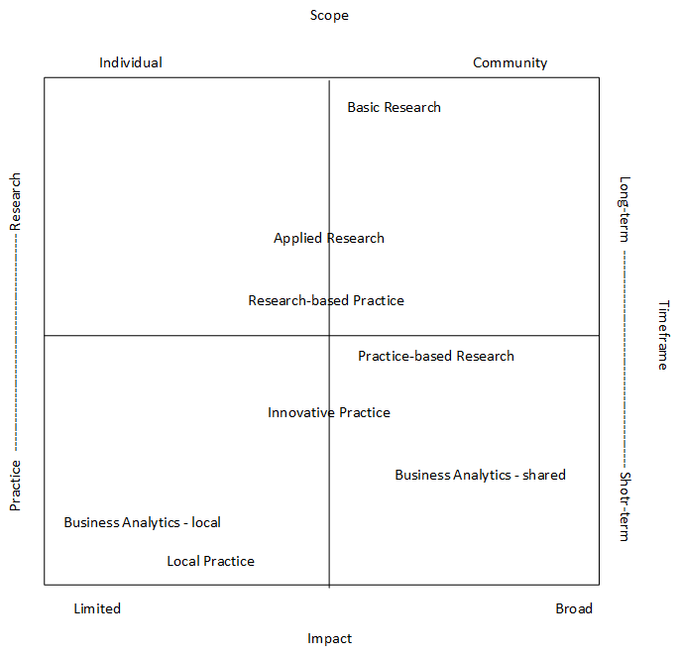
SPN Research & Innovation Framework Continuum Grid June 2020 Aaron Choate Dianne Dietrich Sophia Lafferty-Hess Nance McGovern SPN coordination: Jessica Farrell Jessica Myserson
https://www.softwarepreservationnetwork.org/

Slide 4
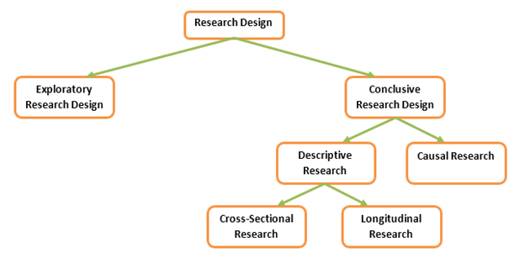
Research Design Classification
http://researchdesignmethod.com/research-design/research-design-classification/

Slide 5
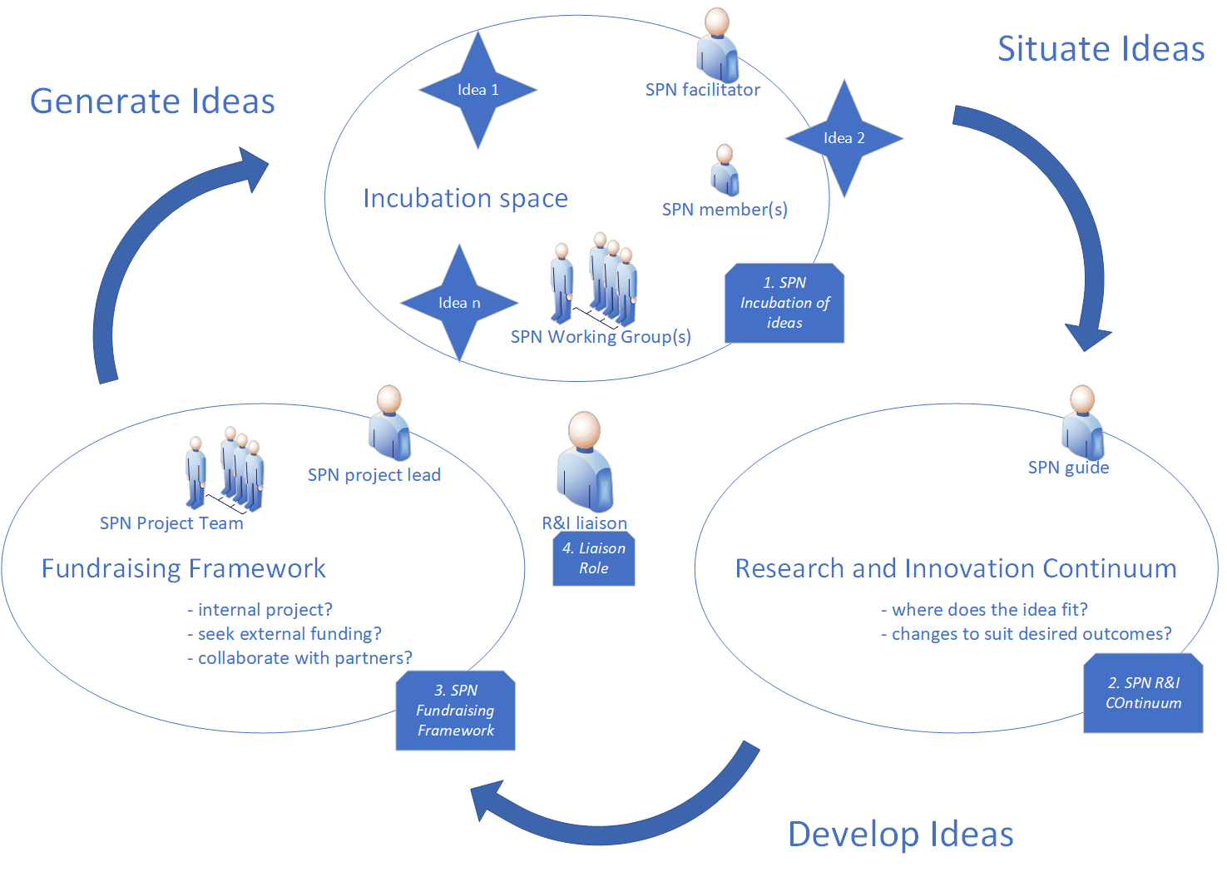
SPN R&I mapping: What might a Research in SAA diagram like this look like? Research Forum CORDA SAAFB Individuals/groups AA / publications more ….

Slide 6
Research Forum: Current programs and services
Full proceedings (abstracts and bios, slides, poster images) since 2007
Research papers since 2008
Research papers with peer review
Research papers without peer review (out of scope, preference)
Research reports (content in any form that supplements/enhances presentation
New this year: recorded sessions that will be shared

Slide 7
Research Forum: Possibilities …
Encourage SAAFB grants recipients to present at Research Forum
Coordinate with AA and SAAFB on calls for specific topics or outcomes
Initiate Research Forum (or simply Research) webinars – with CORDA?
Work with CORDA to adapt the SPN R&I Framework for SAA
Collaborate on building SAA capacity:
Training and partnering on research and innovation: problem statements, methodologies, data visualization, sharing results/findings
Follow up on outcomes – AA, publications, implementation, outreach – thanks, Cal!

Slide 8
Thank you! Stay tuned for Research Forum updates… 2021 will be our 15th Anniversary!

